Slide 1


FANTASY PREMIER LEAGUE
PLAYER POINTS PREDICTOR
Group 7
Ammar
Bhumi
Karan
Yeshovardhan
Shimona

Slide 2
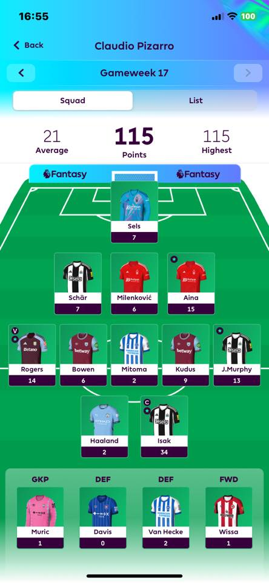
WHAT IS
FPL?
FPL (Fantasy Premier League) is an online football game where you create and manage your own team of real Premier League players. You earn points based on how your selected players perform in actual matches — scoring goals, keeping clean sheets, assisting, etc. It’s all about strategy, transfers, and picking the best squad to outscore others in mini-leagues or globally.

Slide 3

HOW DO
WE HELP?
Our FPL Best Player Predictor simplifies decision-making for Fantasy Premier League managers by recommending top-performing players for the upcoming gameweek. Using machine learning, it analyzes player form, fixtures, and stats to deliver data-driven suggestions. This helps users optimize their transfers, improve overall points, and gain a competitive edge in their mini-leagues—without spending hours on research.

Slide 4




HOW DID WE
Data Collection
DO IT
Scraped player stats from fplform.com — 684 rows, 42 columns.
Data Cleaning & Engineering
Handled missing values, created new features (e.g., goal contributions, threat per 90), and standardized formats.
Exploratory Data Analysis:
Identified trends in player performance, outliers, and correlations. Used ICT Index, EP Next, and total points to understand patterns.
Statistical Testing:
ANOVA for categorical relevance (e.g., player positions)
T-tests and Pearson correlation for numeric feature relationships
Dropped highly correlated feature 'Form' to avoid overfitting

Slide 5


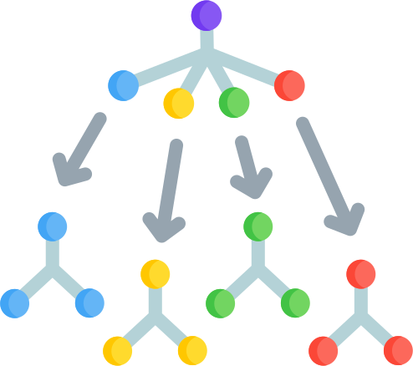
HOW DID WE
DO IT
Feature Selection
Wrapper Method (RFE)
Embedded Method (Lasso)
Filter Methods
Final features balanced predictive power and fantasy football logic.
Model Building & Tuning
Tested Linear Regression, Decision Trees, and k-NN
Used PyCaret for automation and comparison
Final Model: Random Forest Regressor
Train R²: 0.7621
Test R²: 0.7340
Strong generalization and performance

Slide 6
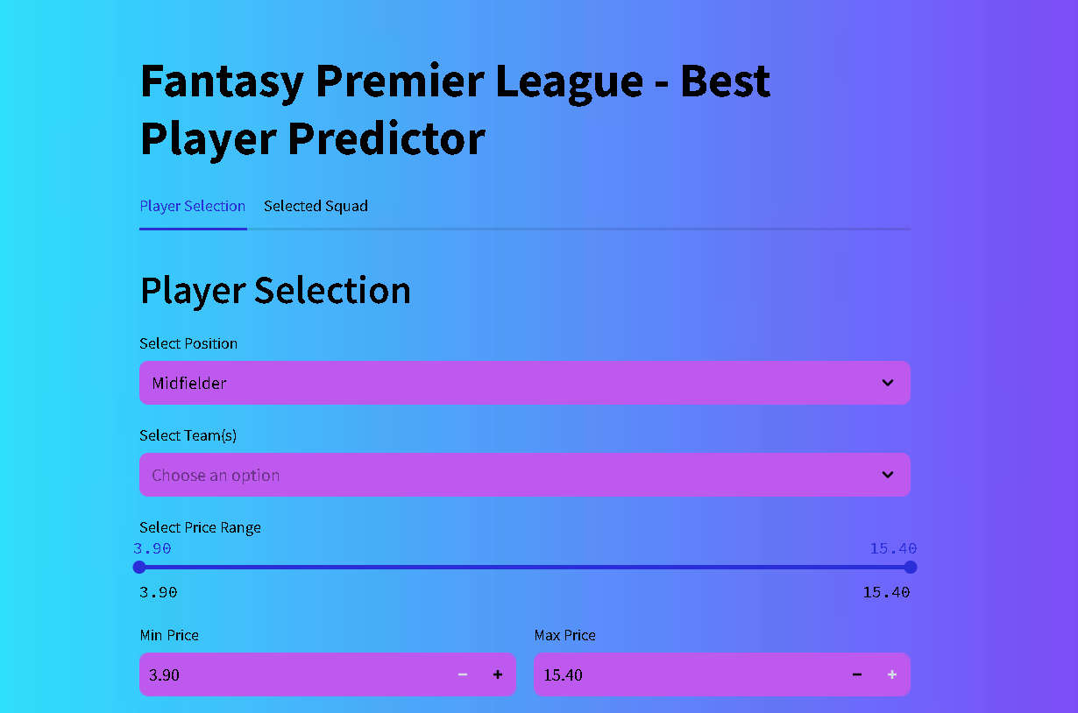
WEB INTERFACE
& DEPLOYMENT
To make our FPL prediction model user-friendly, we built an interactive interface using Streamlit.
Interface Features:
Simple input form where users select budget and position
Displays top player picks with predicted points and key stats
Lightweight and responsive design for easy access
Deployment:
Hosted the app on Hugging Face Spaces, allowing public access without any installation
Integrated the trained model backend with the Streamlit frontend for real-time predictions

Slide 7
LETS HAVE A LOOK
AT THE WEBSITE?
But before that can we get a volunteer
who plays FPL?

Slide 8

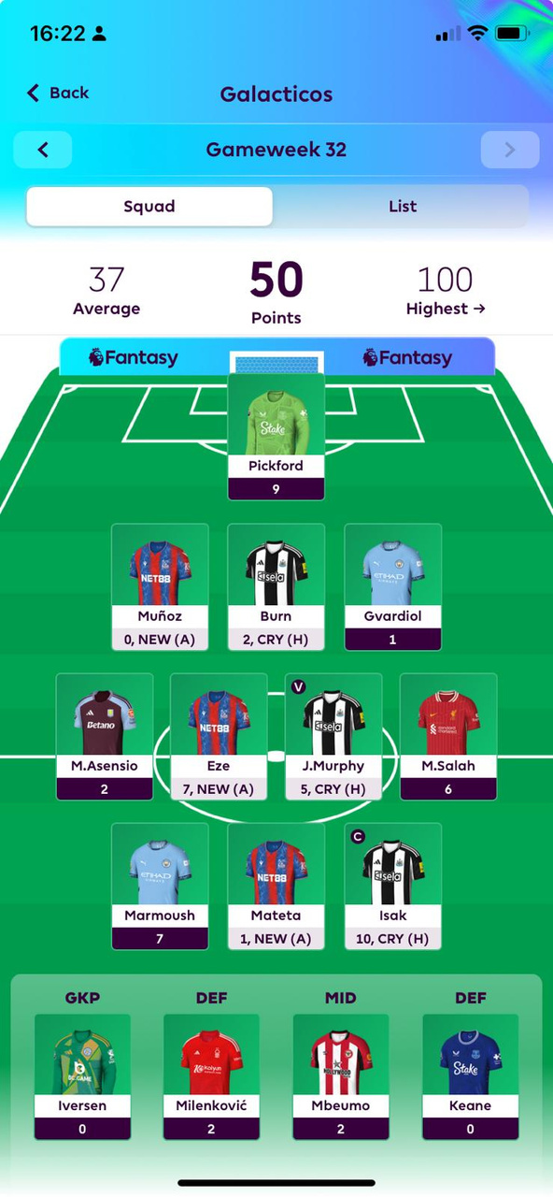
LETS HAVE A LOOK
AT THE USERS TEAM
Which player do you want to replace this week?

Slide 9

LINK TO
WEBITE
https://huggingface.co/spaces/shimona02/FPLPredictor

Slide 10

CONCLUSION
Our FPL Best Player Predictor combines data science with fantasy football strategy to help managers make smarter weekly picks.
Through extensive data cleaning, statistical testing, feature selection, and model tuning, we built a reliable prediction engine with a user-friendly interface.
By deploying the tool on Hugging Face, we made data-driven insights accessible to all — saving users time and improving their chances of climbing the leaderboard.

Slide 11
NAVIGATING
THE FUTURE
Live Data Integration: Automate weekly updates using the official FPL API for real-time player stats, injuries, and fixture changes.
Captain & Transfer Suggestions: Enhance the model to recommend ideal captain picks and optimal transfer combinations.
Team-Based Recommendations: Tailor suggestions based on a user’s current squad and budget constraints.
Mobile Integration: Work toward embedding our model directly into the official FPL app or as a companion plugin — offering one-click insights without switching platforms.

Slide 12
THANK YOU
QUESTIONS?

